Slide 1
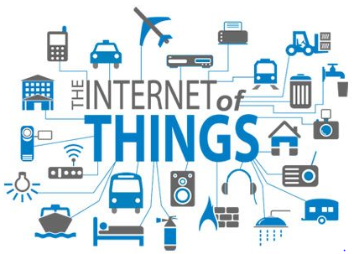

Slide 2
Internet of Things: An Overview
Chapter 1

Slide 3
Internet of things
Internet of Things (IoT) is a concept which enables communication between internetworking devices and applications, whereby physical objects or ‘things’ communicate through the Internet.

Slide 4
IoT Definition
The definition of IoT can be explained as follows:
1. Internet of Things means a network of physical things(objects) sending, receiving, or communicating information using the Internet or other communication technologies and network just as the computers, tablets and mobiles do, and thus enabling the monitoring, coordinating or controlling process across the Internet or another data network.

Slide 5
…IoT Definition
2. Internet of Things is the network of physical objects or ‘things’ embedded with electronics, software, sensors and connectivity to enable it to achieve greater value and service by exchanging data with the manufacturer, operator and/or other connected devices. Each thing is uniquely identifiable through its embedded computing system but is able to interoperate within the existing Internet infrastructure.

Slide 6
IoT Vision
Internet o things is a vision where things (wearable watches, alarm clocks, home devices, surrounding objects) become ‘smart’ and function like living entities by sensing, computing and communicating through embedded devices which interact with remote objects(servers, clouds, applications, services and processes) or persons through the Internet or Near-Field Communication(NFC)etc.

Slide 7
Example:
Internet connected umbrella.
Streetlights in a city

Slide 8
Central command-and- control station
Streetlights
Group 1
Streetlights
Group 3
Streetlights
Group 4
Streetlights
Group 2
I
N
T
E
R
N
E
T
Streetlight
Streetlight
Streetlight
Streetlight
Streetlight
Streetlight
Streetlight
Streetlight
Group controllers 1 and 2
Group controllers 3 and 4
Streetlight
Streetlight
Streetlight
Streetlight
Streetlight
Streetlight
Streetlight
Streetlight
Figure 1.1 Use of Internet of Things concept for streetlights in a city

Slide 9
Smart and Hyperconnected Devices
Hyperconnectivity means use of multiple systems and devices to remain constantly connected to social networks and streams of information.
Smart devices are devices with computing and communication capabilities that can constantly connect to networks.
For example, a city network of streetlights which constantly connects to the controlling station.

Slide 10
Applications (Reporting, analysis, control); Collaborations , Services and processes( involving people and business processes); Servers for data accumulation(storage) at server; Connected data centre; cloud or enterprise server for data abstraction(means aggregation, fusion or compaction and access)
3G, 4G, Internet, Wi-Fi
Edge computing( Data element analysis and transformation) units
Bluetooth, ZigBee or NFC
RFIDs, Wireless Sensor Network(WSNs) and others sources of analog and digital, audio media and video-media inputs; Physical devices with sensors for measuring the pressure, temperature, velocity, relative humidity, audio, video, calories spent and other health parameters.
Figure 1.2 A general framework for IoT using smart and hyperconnected devices, edge computing and applications

Slide 11
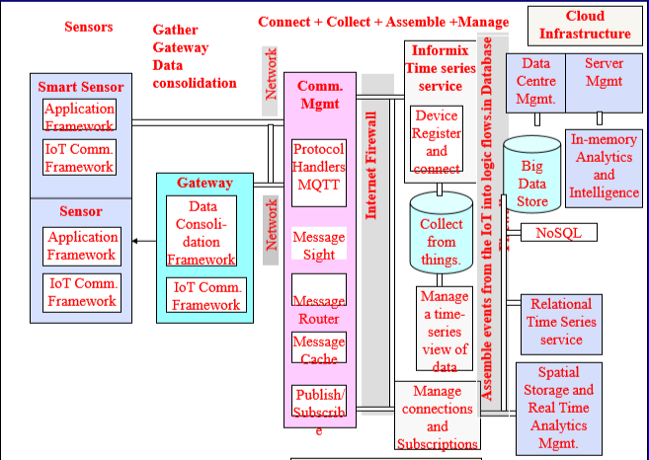
IoT Conceptual Framework

Slide 12
IoT Architectural View
An IoT system has multiple levels. These levels are also known as tiers.
A reference model can be used to depict building blocks, successive interactions and integration.
An example is CISCO’s presentation of a reference model comprising seven levels.

Slide 13
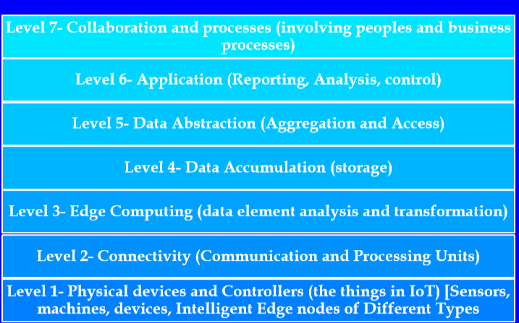
An IoT reference model suggested by CISCO

Slide 14
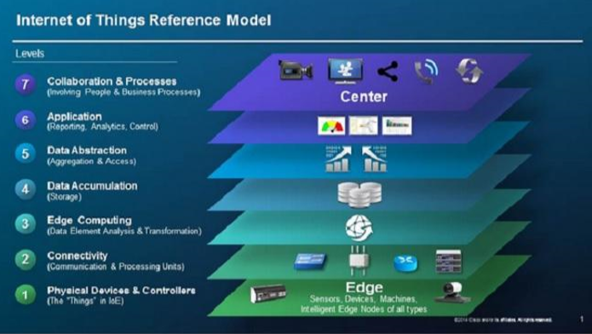

Slide 15
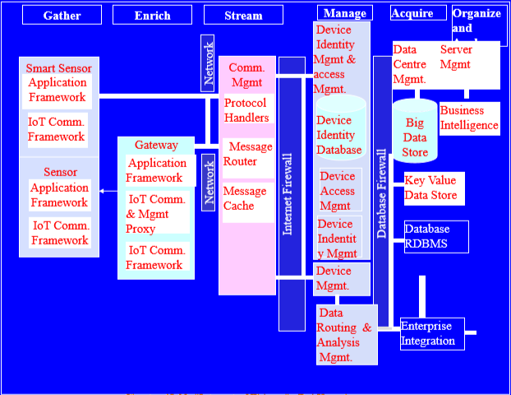
Complex Applications Integration and SoA
Oracles IoT architecture

Slide 16
An architecture has the following features:
The architecture serves as a reference in applications of IoT in services and business processes.
A set of sensors which are smart, capture the data, perform necessary data element anaysis and transformation as per device application framework and connect directly to a communication manager.

Slide 17
A set of sensor circuits is connected to a gateway possessing separate data capturing, gathering, computing and communication capabilities. The gateway receives the data in one form at one end and sends it in another form to the other end.
The communication management subsystem consists of protocol handlers, message routers and message cache.
Management subsystem has functionalities for device identity database, device identity management and access management.

Slide 18
Data routes from the gateway through the Internet and data centre to the application server or enterprise server which acquires that data.
Organisation and analysis subsystems enable the services, business processes, enterprise integration and complex processes.

Slide 19
IEEE suggested P2413 standard
The reference architecture covers the definition of basic architectural building blocks and their integration capability into multi-tiered systems.
P2413 provides for the following:
Follows top-down approach
Does not define new architecture
Gives blueprint for data abstraction

Slide 20
Technology behind IoT
The following entities provide a diverse technology environment and are examples of technologies which are involved in IoT.
Hardware(Arduino Raspberry Pi,Intel Galileo, Intel Edison ,ARM mBed,Bosch XDK110)
Integrated Development Environment (IDE) for developing device software, firmware and APIs.
Protocols
Communication
Network backbone(IPv4,IPv6,UDP and 6LowPAN)
Software(RIOT OS, Eclipse IoT)
Internetwork cloud platforms/Data centre(IBM BlueMix, CISCO IoT, TCS CUP, Iox and Fog)
Machine learning algorithms and software.(GROK)

Slide 21
The following five entities can be considered for the five levels behind an IoT system:
Device platform consisting of device hardware and software using a microcontroller, and software for the device APIs and web applications.
Connecting and networking enabling internetworking of devices and physical objects called things and enabling the internet connectivity to remote servers.
Server and web programming enabling web applications and web services.
Cloud platform enabling storage, computing prototype and product development platforms.
Online transactions processing, online analytics processing, data analytics and knowledge discovery enabling wider applications of an IoT system.

Slide 22
Server-end Technology
Servers offer the following software components:
Online platforms
Devices identification,identity management and their access management
Data aggregation, integration, organising and analysing
Use of web applications, services and business processes

Slide 23
Major Components of IoT System
Physical objects
Hardware
Communication module
software

Slide 24
Sensors and Control Units
Sensors:
Sensors are electronic devices that sense the physical environments.
An industrial automation system or robotic system has multiple smart sensors embedded in it.
Sensor-actuator pairs are used in control systems.
A smart sensor includes computing and communication circuits.
Example :internet of streetlights.
Two types :
Analog
digital

Slide 25
Control Units :
Most commonly used control unit in IoT consists of a Microcontroller Unit(MCU) or a custom chip.
A microcontroller is an integrated chip or core in a VLSI or SoC.
Popular microcontroller are ATMega 328, ATMega 32u4, ARM Cortex and ARM LPC.
An MCU comprises a processor, memory and several other hardware units which are interfaced together.
It also has firmware,timers, interrupt controllers and functional IO units.

Slide 26
Additionally, an MCU has application-specific functional circuits designed as per the specific version of a given microcontroller family.
For example, it may possess Analog to Digital Converters(ADC) and Pulse Width Modulators(PWM).

Slide 27
Microcontroller
Processor
Internal RAM
Internal Flash and Firmware
Timers
Programmable IO Ports
General Purpose IO Ports
Serial IO Ports
PWM (Pulse Width Modulator)
ADC ( Analog to Digital Converter)
Communication Network Interfaces
Figure 1.6 various functional units in an MCU that are embedded in an IoT device or a physical object

Slide 28
Communication Module
A communication module consists of protocol handlers, message queue and message cache.
A device message-queue inserts the messages in the queue and deletes the messages from the queue in a first-in first-out manner.
A device message-cache stores the received messages.

Slide 29
Software
IoT software consists of two components
Software at the IoT device
Software at the IoT server

Slide 30
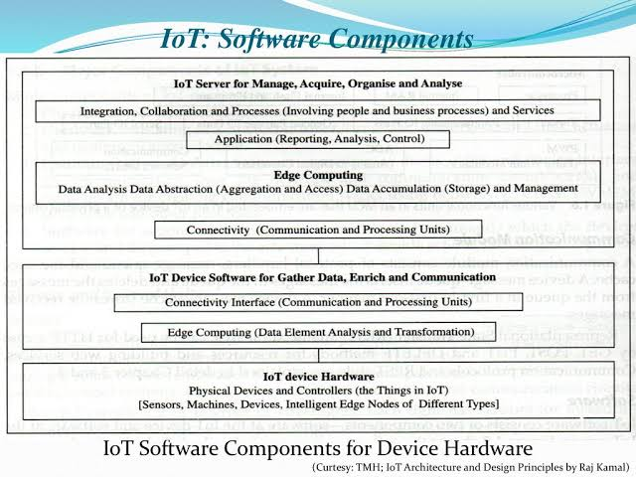

Slide 31
Middleware
OpenIoT is an open source middleware. It enables communication with sensor clouds as well as cloud-based ‘sensing as a service’.
IoTSyS is a middleware which enables provisioning of communication stack for smart devices using IPv6, oBIX, 6LoWPAN, CoAP and multiple standards and protocols.
The oBIX is standard XML and web services protocol oBIX(Open Building Information Xchange).

Slide 32
Operating System(OS)
Examples of OS are RIOT, Raspbian, AllJoyn, Spark and Contiki.
RIOT is an operating system for IoT devices. RIOT supports both developer and multiple architectures, including ARM7, Cortex-M0, Cortex-M3, Cortex-M4, standard x86 PCs and TI MSP430.
Raspbian is a popular Raspberry Pi operating system that is based on the Debian distribution of Linux.
AllJoyn is an open-source OS created by Qualcomm.
It is a cross platform OS with APIs available for Android, IOS, OS X, Linux and Windows OSs.
Spark is a distributed, cloud-based IoT operating system and web-based IDE. It includes a command-line interface, support for multiple languages and libraries for working with several different IoT devices.
Contiki OS is an open source multitasking OS. It includes 6LowPAN, RPL, UDP, DTLS and TCP/IP protocols which are required in low-power wireless IoT Devices.

Slide 33
Firmware
Thingsquare Mist is an open-source firmware(software embedded in hardware) for true Internet-Connectivity to the IoT.
It enables resilient wireless mesh networking.

Slide 34
Development tools and Open-source framework for IoT implementation
Eclipse IoT provides open-source implementation of standards such as MQTT CoAP, OMA-DM and OMA LWM2M, and tools for working with Lua, services and frameworks that enable an Open Internet of Things.
Eclipse website provides sandbox environments for experimenting with the tools and a live demo.

Slide 35
Continue..
Arduino development tools provide a set of software that includes an IDE and the Arduino programming language for a hardware specification for interactive electronics that can sense and control more of the physical world.
Kinoma software platform- Kinoma Create, Kinoma Studio development environment and Kinoma Platform Runtime are three different open-source projects. Kinoma Connect is a free app for iOS and Android smartphones and tablets with IoT devices.

Slide 36
APIs and Device Interfacing Components
Connectivity interface consists of communication APIs, device interfaces and processing units.

Slide 37
REST API
Administration and Security Management
Data flow and device management
Multi-tenancy
authentication
directory
subscription
REST
Publish/Subscribe
LWM2M
Device Interface
CoAP-SMS,CoAP-MQ,CoAP
CoAP, HTTP,MQTT
DTLS
TLS
Figure 1.8 mBed API and device interfacing components

Slide 38
Platforms and Integration Tools
ThingSpeak is an open data platform with an open API. It consists of APIs that enable real-time data collection, geolocation data, data processing and visualisations.
It can process HTTP requests and store and process data. It can integrate multiple hardware and software platforms.
An important feature of ThingSpeak is the support to MATLAB data analytics, mobile, web applications and social networks.

Slide 39
Nimbits is a cloud platform which supports multiple programming languages, including Arduino, JavaScript, HTML or the Nimbits.io Java library.
It processes a specific type of data and can also store the data. The data can be time-or geo-stamped.

Slide 40
IoT Toolkit offers Smart Object API, HTTP-to-CoAP semantic mapping and a variety of tools for integrating multiple IoT-Related sensor networks and protocols.
SiteWhere provisions a complete platform for managing IoT devices. It enables gathering of data and integrating it with external systems. SiteWhere can be used on Amazon’s cloud or downloaded.

Slide 41
Sources Of IoT
Examples of hardware sources for IoT prototype development are Arduino Yun, Microduino, Beagle Board and RasWIK.
Hardware prototype needs an IDE for developing device software, firmware and APIs.

Slide 42
Popular IoT Development Boards
Arduino Yun
Microduino
Intel Galileo
Intel Edison
Beagle Board
Raspberry Pi Wireless Inventors Kit(RasWIK)

Slide 43
Arduino Yun
Arduino Yun board uses microcontroller ATmega32u4 that supports Arduino and includes Wi-Fi, Ethernet, USB port, micro-SD card slot and three reset buttons.
The board also combines with Atheros AR9331 that runs Linux.

Slide 44
Microduino
Microduino is a small board compatible with Arduino that can be stacked with the other boards.All the hardware designs are open source.
Intel Galileo
Intel Galileo is a line of Arduino-certified development boards. Galileo is based on Intel x86 architecture. It is open-source hardware that features the Intel SOC x1000 Quark based Soc.
Galileo is pin-compatible with Arduino. It has 20 digital I/O, 12-bit PWM for more precise control, six analog inputs and supports power over Ethernet.

Slide 45
Intel Edison
Intel Edison is a compute module. It enables creation of prototype and fast development of prototyping projects and rapidly produces IoT and wearable computing devices.
It includes foundational tools. The tools collect, store and process data in the cloud , and process rules on the data stream.

Slide 46
Beagle Board
Beagle bone based board has very low power requirement. It is a card-like computer which can run Android and Linux. Both the hardware designs and the software for the IoT devices are open source.
Raspberry Pi Wireless Inventors Kit(RasWIK)
RasWIK enables Raspberry Pi Wi-Fi connected devices. It includes documentation for 29 different projects or you can comp up with one of your own.

Slide 47
Role of RFID and IoT Applications
RFID enables tracking and inventory control, identification in supply chain systems, access to buildings and road tolls or secured store centre entries, and devices such as RFID-based temperature sensors.
RFID networks have new applications in factory design, leasing, insurance and quality management.

Slide 48
Wireless Sensor Networks(WSNs)
Sensors can be networked using wireless technology and can cooperatively monitor physical or environmental conditions.
Sensors acquire data from remote locations, which may not be easily accessible. Each wireless sensor also has communication abilities for which it uses a radio-frequency transceiver.
Each node either has an analog sensor with signal conditioner circuit or a digital sensor.
Sensing can be done to monitor temperature, light intensity, presence of darkness, metal proximity, traffic, physical, chemical and biological data etc.

Slide 49
WSN Definition
Wireless Sensor Network(WSN) is defined as a network in which each sensor node connects wirelessly and has capabilities of computations for data compaction, aggregation and analysis plus communication and networking. WSN node is autonomous. Autonomous refer to independent computing power and capability to send requests and receive responses , and data forward and routing capabilites.

Slide 50
A web source defines the WSN as “ a wireless network consisting of spatially distributed autonomous devices using sensors to cooperatively monitor physical or environmental conditions such as temperature, sound, vibration, pressure , motion or pollutants at different locations.”

Slide 51
WSN Node
A WSN node has limited computing power. It may change topology rapidly. The WSN network in the topology-changing environment functions as an as-hoc network. A WSN network in that environment is generally self-configuring, self -organising , self-healing and self- discovering.

Slide 52
M2M Communication
Machine –to-machine refers to the process of communication of a physical object or device at machine with others of the same type, mostly for monitoring but also for control purposes.
Each machine in an M2M system embeds a smart device. The device senses the data or status of the machine, and performs the computation and communication functions.

